Slide 1
Who owns the social web ??
TEAM 12
Avinash Banala-5
Sai Smaran Chinthala-11
Rahul Nagavalli-28
Swetcha Reddy Vangala-41

Slide 2
INTRODUCTION
User-contributed Content plays an increasingly important role in the Internet’s evolution, overtaking professionally created and curated resources.
Improved editing and sharing applications facilitate other aspects of media creation, including larger-scale collaborative efforts.
Intellectual property law and social norms concerning content ownership are diverging in conspicuous ways; we find that legally contentious actions (such as downloading and saving content) may seem benign to most Internet users.
Everyday reuse of social media content is opportunistic, pragmatic, and highly contextual; users reason about the fairness of reusing other people’s content but do not necessarily trust them to do the same.

Slide 3
CONT..
Many social, legal, and technological forces shape our perceptions of who can do what with Internet content.
In Order Without Law, property law scholar Robert C. Ellickson demonstrated how people settle their disputes and regulate their behaviour via these social norms.
His analysis shows the importance of the norms and how they can be as effective as law.
Although people are aware there are legal prescriptions for ownership and its reach, they are guided instead by social norms.

Slide 4
UNCOVERING SOCIAL NORMS
One must identify people’s current practice (what they do), both as media consumers and as media creators, and we need to get them to articulate their aspirations.
Authors screened participants for familiarity with the content type or social media service in question, then checked responses according to documented criteria to ensure the study had been completed in good faith, a process detailed in articles covering the individual studies.
Authors collected valid responses from a total of 1,738 participants. Many had attended college; approximately one third were students at the time of the study.
Most were between 18 and 40, although close to 20% were over 40 at the time of the study.

Slide 5
CONT..
Participants were generally both content consumers and creators.
Two-thirds of them in the six studies after 2012 had been on the Internet more than 10 years.
Authors adapted a technique that has been used successfully in legal education and legal argument analysis: scenarios (or cases) plus hypotheticals.
The scenarios and hypotheticals are both more engaging than an abstract version of the question.
Authors captured participant reactions using a seven-point Likert scale, from strongly disagree to strongly agree.
Each study presented from 16 to 28 hypotheticals

Slide 6
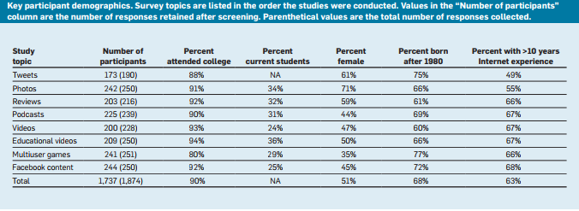
STATISTICS

Slide 7
Common User Actions
Saving: The act of intentionally downloading content from a social media site or service and storing it to a place under the user’s control
Sharing: Sharing reposting existing user-contributed media on another site or service, possibly without attribution, along with varying degrees of content transformation and varying user intent
Removing: It is deleting or limiting access to user-contributed content. Removal is an action that tests the limits of media ownership and control, since it is not usually supported if the remover is not the explicit content owner

Slide 8
Media-Independent Features
Original Context: This feature tests whether the content’s original context influenced our study participants’ perceptions of ownership rights
User’s relationship to content: This feature tests some of the complexities of ownership

Slide 9
Cont.…
Commercial concerns: This feature considers users’ understanding of corporate ownership rights, as well as commercial use by individuals, apart from any terms and conditions spelled out by the service.
Disaggregation: Disaggregation tests whether the rights to constituent parts of an item are different from the rights to the whole.

Slide 10
Saving Social Media
In the surveys, They define saving as an intentional act of downloading something— a photo, podcast, document, or video—to user-controlled storage to maintain a copy, rather than a side effect of performing some other action
Users may save content because they fear its owner will delete it, because the site itself offers no guarantee of permanence
They want to have a copy on hand

Slide 11
Two Aspects of Saving
Saving to Cloud Storage: It is a seamless extension of local storage. It is never fully under user control, and service provider terms and conditions may apply. From a rights perspective, is saving downloaded content to local storage different from saving it to private cloud storage
Limits: Responses to hypotheticals in the surveys suggest people expect to be able to download much of what they encounter online. This baseline may be tested by imposing artificial limits

Slide 12
Weaker effects in the Survey
First, saving to the cloud is viewed differently from saving to local storage.
A Skype based video was stored to a user’s loval hard drive and in the second to a cloud storage service.
In the first hypothetical , 18% disagreed with an individual’s right to record the video and save it.
In the second, the disagreement jumped to 30%.
A second effect stems from users expectations that certain media types associated with communication will remain ephemeral.

Slide 13
Reusing Social Media
Reuse is one of the more contentious aspects of current legal interpretation of copyright and fair use.
The reuse scenarios and hypotheticals examined at least eight features. Original context, commercial concerns, genre-derived properties , disaggregation
Public good:
They seek a balance between individual rights and public interest access.

Slide 14
Permission
In the early studies, they revealed that some participants thought permission was essential bridge.
Later studies tested the mitigating force of permission with hypotheticals.
Venue and Purpose
The surveys used hypotheticals to compare reuse of the same content in varying contexts.
This practice is common, as personal information is analyzed to draw conclusions about users as a group or to target advertising.

Slide 15
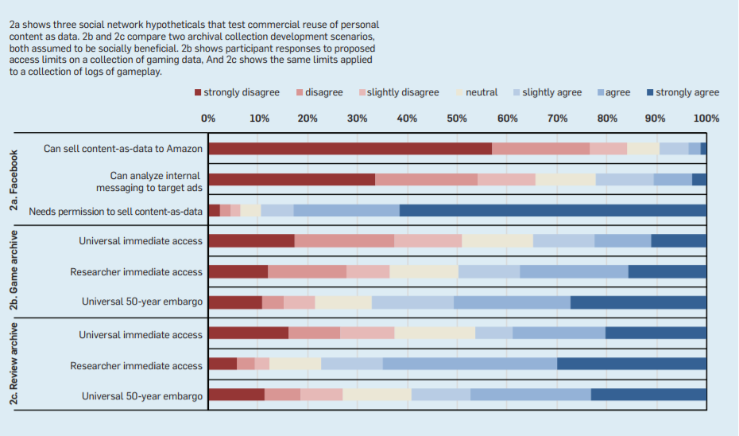

Slide 16
Reusing information in a way that changes the information’s veracity got more disapproval than benign reuse.
Contrast are the negative responses.
Reuse for social good is viewed more skeptically than reuse of nominally humorous content.
Three or more associated hypotheticals included in each survey tested different access restrictions on these archives.
Study participants are increasingly aware of what they give up when they describe themselves

Slide 17
removing social media
Content removal by person other than who posted it is most speculative.
3 reasons:
Personal information management task
Online identity management
Understanding of privacy

Slide 18
Three variants
Changes in remover’s relationship to the content
Circumstances in which a neutral non-owner can remove material
Situations in which removal requires requesting and receiving permission

Slide 19
example
BOOK REVIEW SCENARIO
Negative book review posted by a seven-year old girl, which was actually written by her father.
WHO HAS THE AUTHORITY TO REMOVE IT?

Slide 20
conclusion
Save anything but respect explicit social constraints
Concern for control of self-presentation
Reuse norms reflect some aspects of fair use and ignore others
A right to veracity
Highly circumstantial reasoning about reuse

Slide 21
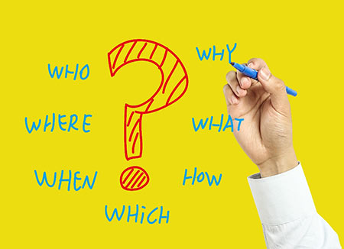
Questions ??

Slide 22


